Slide 1

ui design & implementation
Task 5 – by group 2

Slide 2
Introduction
This task focuses on the UI design and frontend implementation of the CarCare mobile application.
The app serves both car owners and mechanics.
We prioritized usability, aesthetics, and responsiveness using design tools and mockups.
Built using React Native with Expo and TypeScript.

Slide 3

App Identity: CarCare
App Name
Logo Design
CarCare
The logo features a teal car outline with a heartbeat line and a wrench symbol, visually representing car diagnostics and repair. This reinforces our identity as a car maintenance assistant.
Purpose
Helps users identify and manage car issues.
User Types
Car Owners & Mechanics
Brand Theme
Reliable, intelligent, and user-friendly
Slogan
Diagnose. Understand. Repair

Slide 4



Visual Identity: Color Scheme and Typography
Our visual design prioritizes a clean, minimalist aesthetic to enhance usability and reduce cognitive load. We selected Teal as the primary color, representing calmness, trust, and technology, complemented by supporting colors for high readability and professionalism.
Color Scheme
Primary: Teal (#00796B), Secondary: White (#FFFFFF), Accent: Light Teal / Aqua, Text Color: Black or Navy-Blue. Chosen for trust, technology, and high readability.
Fonts and Typography
Clean, sans-serif fonts for clarity and professionalism

Slide 5

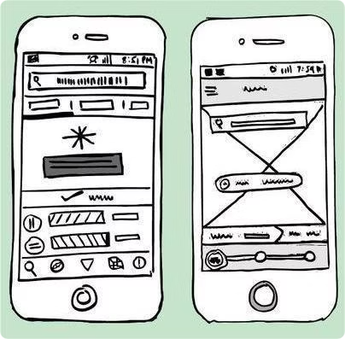
Visual Design Strategy
Principles and Mockups
CarCare's visual design strategy is built on core principles to ensure a seamless user experience.
Design Principles
Consistency: Unified UI elements.
Minimalism: Clean interface, easy navigation.
Responsiveness: Adaptable to various screen sizes.
Accessibility: Good contrast, readable fonts.
Wireframes & Mockups
Created in Figma before development
Simulates real user flow
Key screens: Splash, Login, Sign-up, Dashboard, Diagnostic Result

Slide 6
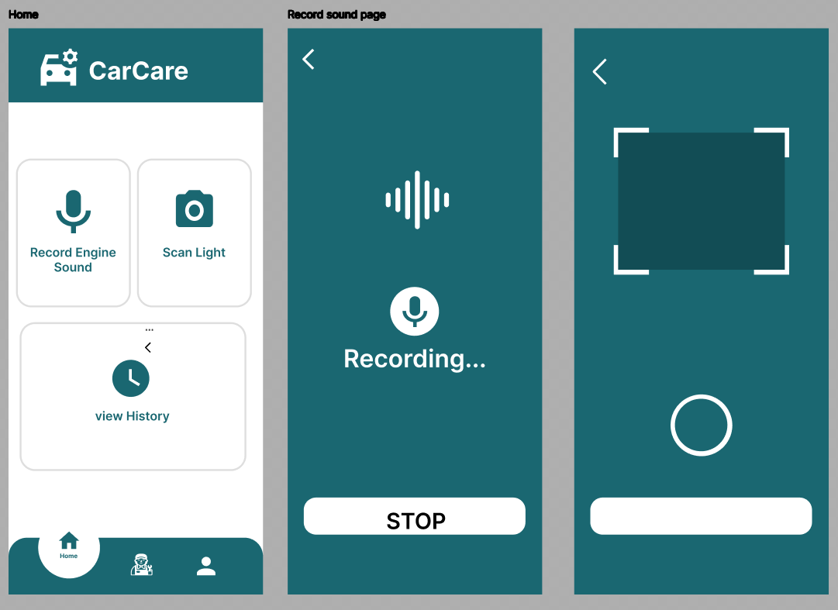
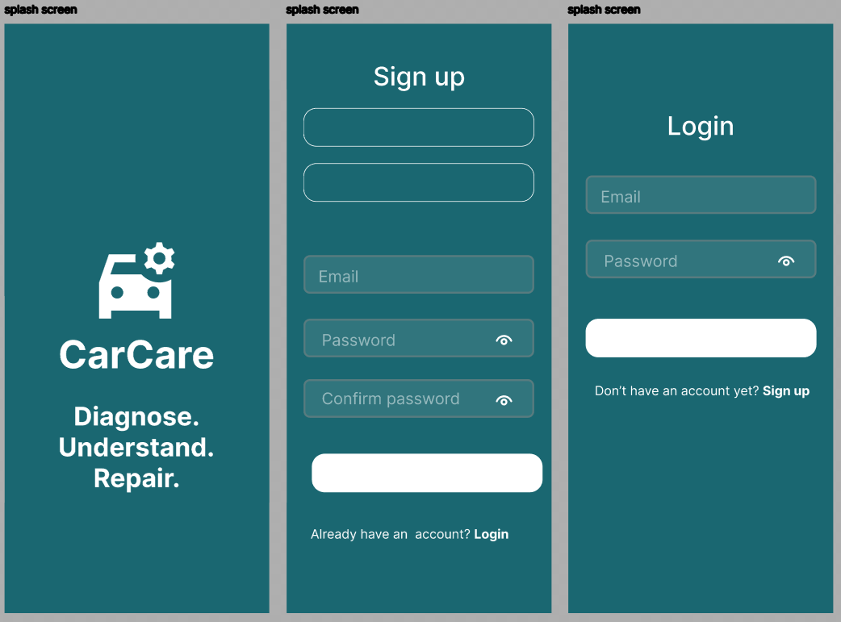
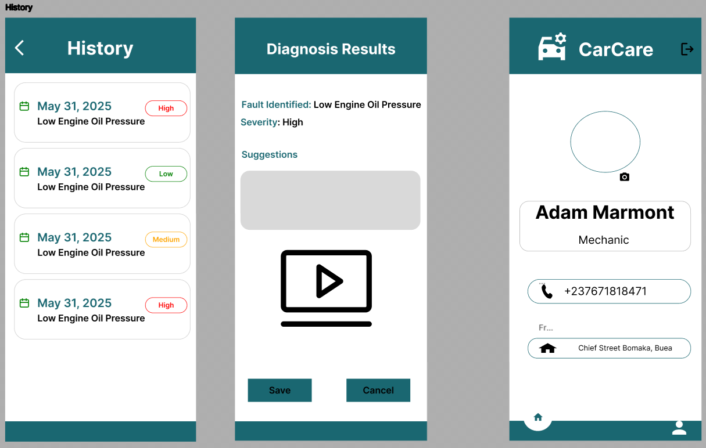

Slide 7




Frontend Implementation
Technology Stack
React Native
For building native mobile applications with JavaScript and React.
Expo
For cross-platform development, simplifying the build process.
TypeScript
For enhanced code quality and maintainability with static typing.

Slide 8
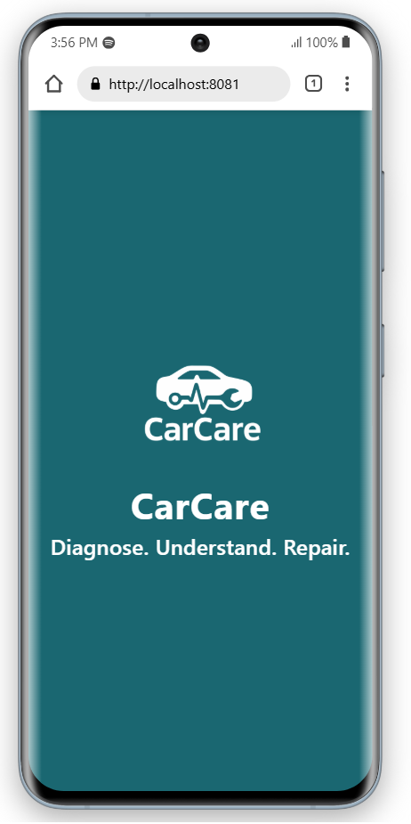




Pages Implemented
We have implemented a comprehensive set of pages to support both car owners and mechanics, including various dashboards and interactive features. These pages incorporate form validation, conditional rendering, and navigational routes for a seamless user experience.
Splash & Auth Screens
Splash Screen, Login and Sign-up Pages for both user types.
User Dashboards
Dedicated dashboards for Car Owners and Mechanics.
Diagnostic Tools
Dashboard Light Scan Page (camera access) and Record Engine Sound Page (microphone input).
Results & Profiles
Diagnostic Result Page, Mechanic Profile Form, User Profile and History Pages.

Slide 9
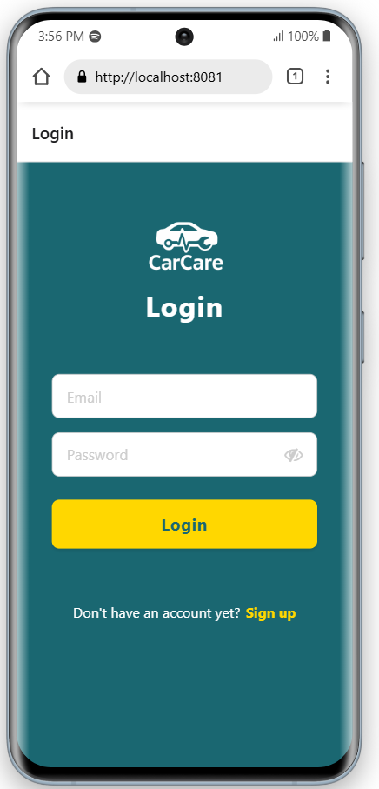
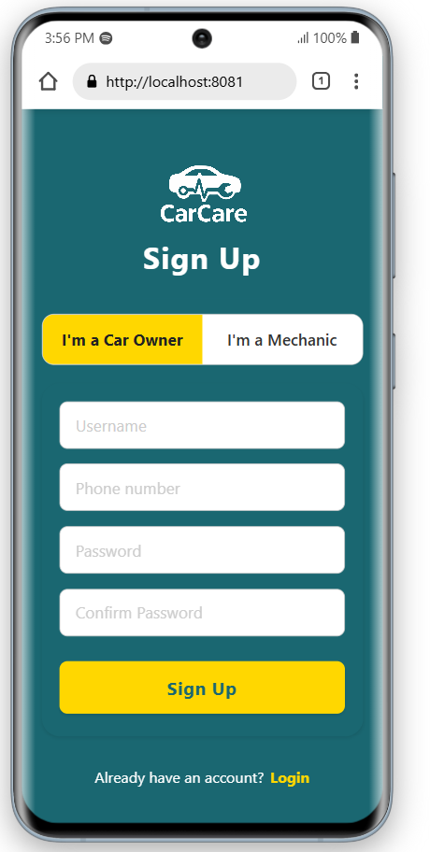
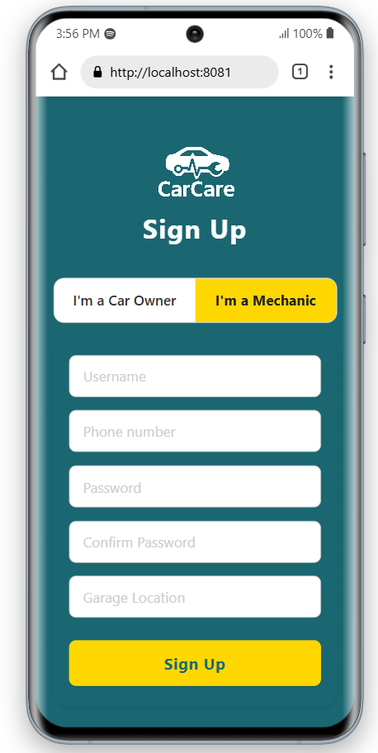
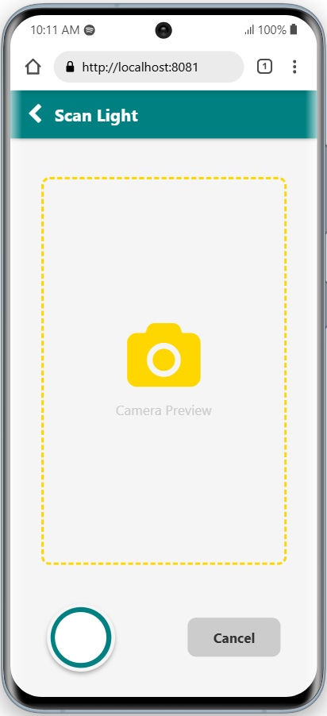

Slide 10
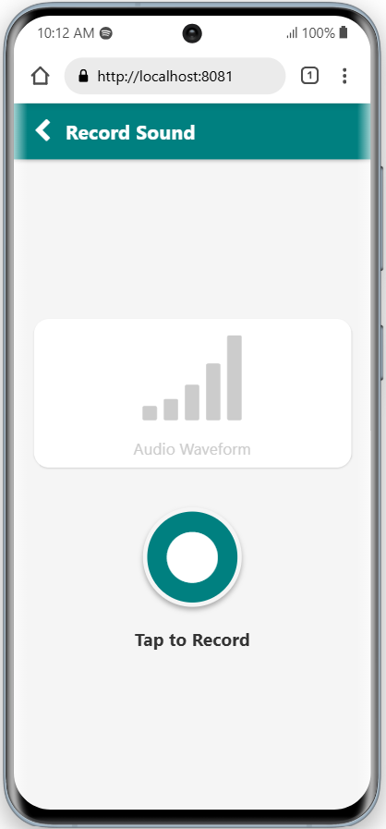
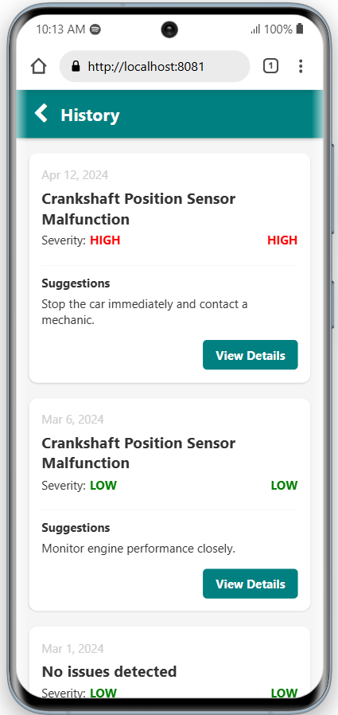
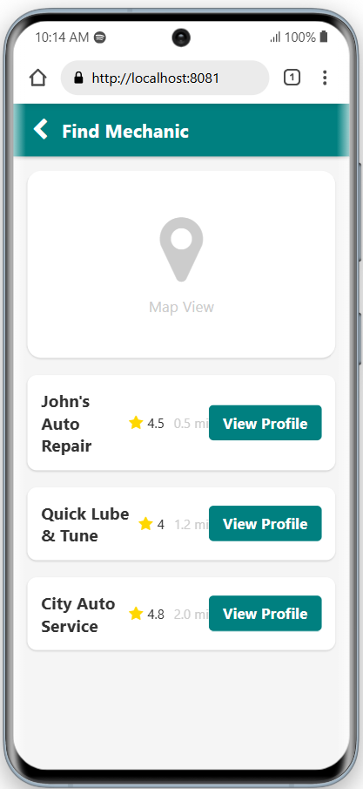
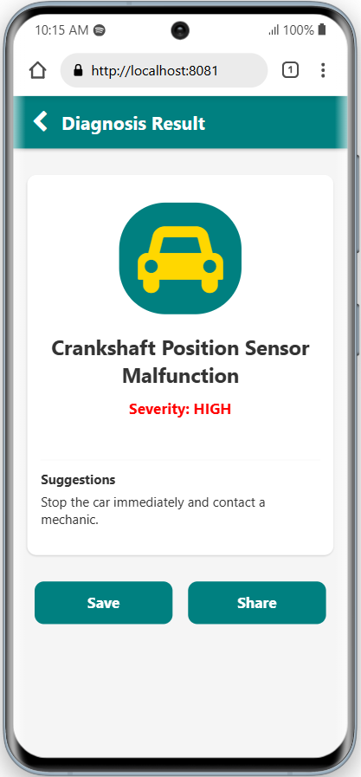

Slide 11




Conclusion
The CarCare user interface has been meticulously planned and structured to ensure usability, accessibility, and purpose-driven interaction. The design effectively supports the app's goal of delivering accurate diagnostics and helpful repair guidance.
UI is purpose-driven and user-focused
Role-based design enhances personalization
Modern tech stack ensures cross-platform support
CarCare is ready to deliver value to drivers and mechanics

